Slide 1


Objective Bayesian Hypothesis Testing
Alex Deng @ Microsoft 2015
The 1st Workshop on Offline and Online Evaluation of Web-based Services

Slide 2


Slide 3
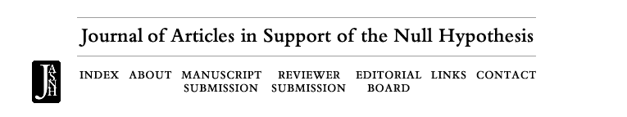
Crazy? Not Entirely
Many published research findings found not reproducible.
Notable/Surprising results even more so
“The fluctuating female vote: Politics, religion, and the ovulatory cycle”
P-value hack
Multiple testing: different testing methods used by different groups of researchers repeatedly on the same data
Optional stopping: stop recruiting subjects once the test is “statistically significant”
File Drawer Effect and Publication Bias

Slide 4
Pathology of Null Hypothesis Statistical Testing
Null and Alternative is asymmetric.
Test only try to reject null, and gather evidence against the null
Even with infinite data, will never accept the null with 100% confidence
Multiple testing
Optional Stopping/Early stopping
“Genuine” Prior information not used
Researchers motivated to publish counter-intuitive results, which are more often not reproducible

Slide 5
Frequentist NHST’s philosophy is opportunistic
-Brad Efron, A 250-YEAR ARGUMENT: BELIEF, BEHAVIOR, AND THE BOOTSTRAP
Notes:
Opportunistic nature explains why nhst has those issues

Slide 6
Frequentist vs Bayesian: Two Trial Systems
Frequentist:
One group of jury, with presumption of innocence, reckoning evidence of being guilty
Bayesian:
Two groups of jury, one reckon the evidence of being guilty, the other reckon the evidence of being innocent
Judge make final decision based on decisions of both jury, together with prior belief
Benefit of two jury system
Symmetry
Principled, not opportunistic anymore. Think multiple testing, both two groups of jury will share the same multiple testing dividend and the judge can still make a balanced call

Slide 7

Bayesian Two Sample Hypothesis Testing
1. H0 and H1, with prior odds
$$PriorOdds= \frac{P\left(H1\right)}{P\left(H0\right)}$$
2. Given observations, likelihood ratio(Bayes Factor)
$$LR= \frac{P\left(Data | H1\right)}{P\left(Data | H0\right)}$$
3. Bayes Rule
$$\frac{P\left(H1 | Data\right)}{P\left(H0 | Data\right)}=PriorOdds×LR=\frac{P\left(H1\right)}{P\left(H0\right)}×\frac{P\left(Data | H1\right)}{P\left(Data | H0\right)}$$

Slide 8
Bayesian Advantages
Multiple testing
Optional stopping/early stopping
Smoothing /Regularization
Useful Prior information
Twyman’s law “Any piece of data or evidence that looks interesting or unusual is probably wrong!”
More intuitive result
P-value often misunderstood
Business executives and engineers naturally understand P(H1|Data)
Accepting the Null
Meta Analysis: combine results from different studies

Slide 9
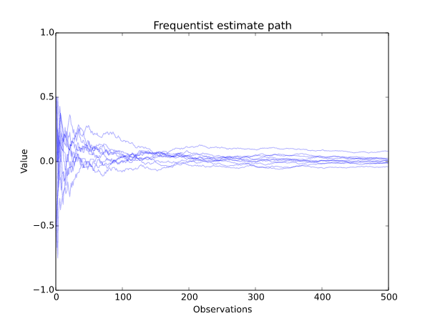
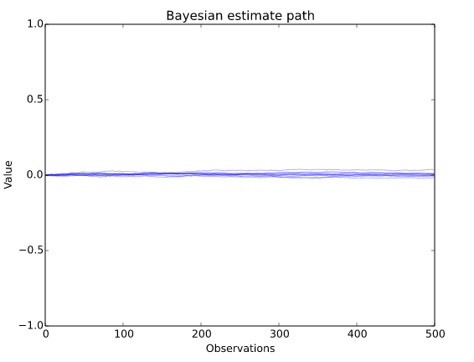
Why Not Everyone Is a Bayesian?
Prior is often subjective, Conjugate prior often used for closed formula
So called “non-informative” priors are never truly informative
Lindley’s Paradox: uniform prior carries a lot of information
Many above Bayesian Advantages only applies when we know the true prior(genuine prior)
Notes:
Bayesian path is a smoothed/regularized version of the frequentist path. knowledge of prior is equivalent to set the right amount of smoothing/regularization

Slide 10
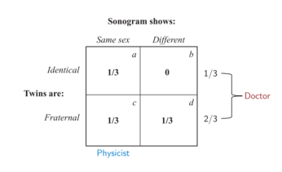
Common Ground: the Twin Problem
A pregnant physicist knows she is having twin boys
Identical twin or fraternal twin?
Dr. says based on birth data, 1/3 twins
are identical and 2/3 are fraternal
Bayes Rule:
PriorOdds: P(Identical)/P(Fraternal) = ½
LikelihoodRatio:
P(Data|Identical)/P(Data|Fraternal) =
1/(1/2) = 2
Posterior Odds:
PriorOdds * LikelihoodRatio = 1
=> P(Identical|Data) = P(Fraternal|Data) = 1/2
Notes:
Frequentist and Bayesian reach to common conclusion, if they trust the doctor’s data

Slide 11
Compare to Hypothesis Testing
Similarities
Both are testing two hypotheses
Both have some data observed
Dissimilarities
Twins: the variable of interest can be observed
Testing: we never observe the variable of interest (Null or Alternative)
we only observe metric movements, a noisy version of it
The Dr’s input is critical in twin’s problem, it provides an objective prior assessment
Do we have similar input in AB Testing?

Slide 12
Learning Prior Objectively
How does the doctor know the prior?
Historical Birth Data!
Estimate the prior using frequentist methods, e.g. MLE, confidence interval, etc.
If we have historical experiments with oracle label, i.e. Null or Alternative, we can easily do the same thing to know prior P(Null) and P(Alternative)
Reality: we don’t have label, and also we don’t know the distribution of treatment effect

Slide 13

Notation
$tstat=\frac{Δ}{\begin{aligned}\sqrt{\frac{σ_{t}^{2}}{N_{T}}+\frac{σ_{c}^{2}}{N_{C}}} \\ \end{aligned}}$ , NEff (effective sample size): $\frac{1}{\frac{1}{N_{T}}+\frac{1}{NC}}$
Sigma (Pooled SD): $\sqrt{\frac{σ_{t}^{2}}{N_{T}}+\frac{σ_{c}^{2}}{N_{C}}}/\sqrt{NEff}$ , $δ$ (Effect Size) : $\frac{Δ}{Sigma}$
tstat = $δ/\sqrt{\frac{1}{NEff}}$ turn two sample into one sample problem
E($δ$) = $μ$ (treatment effect scaled by Sigma)
Make more sense to put prior on effect size since it is scale-invariant
Notes:
All these notation is to translate two sample hypothesis testing to one sample problem

Slide 14

Two Group Model
Prior: Any Feature has
P(H1) = p to have an effect
P(H0) = 1-p to be flat
Under H0, $μ=0$
Under H1, $μ∼N(0,V^{2})$ (normal for practical simplicity, could be any distribution)
We observe:$δ= \frac{Δ}{Sigma}\sim N(μ,\frac{1}{NEff})$ (given $μ$)
Things to inference:
Based on observation $δ$, what is $P\left(H1 | Data\right)$ and $P\left(H0 | Data\right)$
What is the distribution of $μ$ given the observation?

Slide 15
Model Fit
Given a set of historical experiment data
If we know the label(H0 or H1), we can estimate p and V
If we know p and V, we can estimate P(H1|Data) and P(H0|Data) for each historical experiment
P(H1|Data) and P(H0|Data) are like Soft-Label/Fuzzy-Label in step 1. We can iterate between 1 and 2 until convergence!
This is classic Expectation-Maximization!
Converge to MLE of p and V
Called MLE-II(MLE of hyper-parameter) or Empirical Bayes

Slide 16
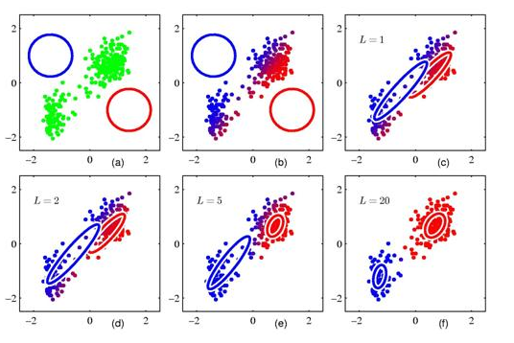
Soft K-means(Bishop)

Slide 17
Does it work?
If I randomly simulate data from H0, can this algorithm converges to P(H0) = 100%?
If I randomly simulate x% from H0 and 1-x% from H1 with a given V, can this algorithm converge to P(H1)=x% and V = V?
Answer in general is yes if we have more than 1000 historical data points. Estimation is also reasonable for more than 200 historical data points
This is properties of MLE, as this algorithm estimates MLE and MLE is consistent
For 1, we need to bound V away from 0. otherwise H1 = H0 and there is no way to separate these two

Slide 18

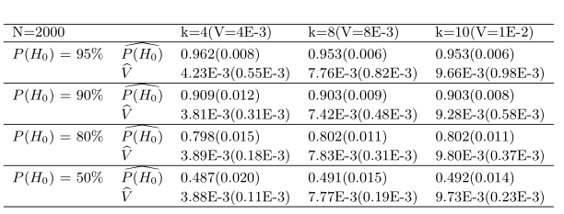
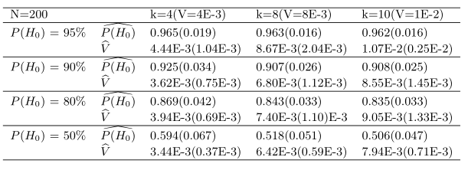
Simulation Results
Common set up: NEff (effective sample size) = 1E6
P(H0) = 100%
N here is the number of historical data points
P(H0) and P(H1) mixed
Varying V, the larger the V, the easier the problem
We vary V by changing k where V = k*1/sqrt(NEff), see later for intuition

Slide 19
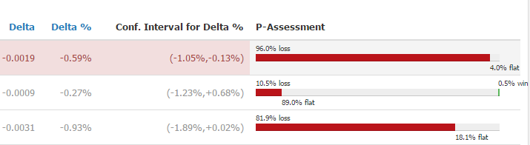
Bing Results/Presentation
Metric | P(H0) | P(H1)
X1 | 97.63% | 2.37%
X2 | 99.80% | 0.20%
X3 | 90.60% | 9.40%
X4 | 98.77% | 1.23%
X5 | 78.55% | 21.45%
X6 | 97.41% | 2.59%
X7 | 97.75% | 2.25%
X8 | 35.50% | 64.50%
X9 | 85.73% | 14.27%
X10 | 98.35% | 1.65%
X11 | 89.25% | 10.75%
X12 | 81.02% | 18.98%
X13 | 73.79% | 26.21%
X14 | 65.57% | 34.43%
X15 | 71.18% | 28.82%
X16 | 66.74% | 33.26%
X17 | 68.12% | 31.88%
Device | Metric | PFlat
Mobile | X | 66.07%
Desktop | X | 81.02%
Mobile | X(Capped) | 61.85%
Desktop | X(Capped) | 75.19%
User Engagement Metrics harder to move, e.g. active days per user, visits per user
Revenue easier to move than engagement
Signals on a module or part of page much easier to move than whole page
Capping metrics for highly skewed distribution increased sensitivity (KDD 2013, Online Controlled Experiments at Large Scale)
Variance Reduction method helps (CUPED, WSDM 2013)
Different devices, product areas have different priors

Slide 20
FAQ
How to pick a historical experiment corpus?
Ideally, you want a corpus that represents the type of experiment you are running
This is like matching in observational data causal inference. Practically, we can just use product area and type of treatments, e.g. UX change, Algo change or Perf change
Why should I believe my experiment now is “like” those from a year ago?
Even for the same product area, your success rate might change. So some kind of time-dependent weighting might be needed in areas where a lot of changes are going on.
Any other distributions for effect size beyond normal?
Maybe the real distribution has heavier tail. In theory you can use any parametric model and learn parameters. But more parameters mean you need more historical data to get a good estimation.

Slide 21
FAQ
What if my historical data is limited
Classic cold start problem. One solution is to use full Bayesian, put a prior on prior. EM -> Variational Bayes
Intuitively this is like start with “population mean” and gradually converge to the true “subgroup mean”

Slide 22
Conclusion
Bayesian framework provides a unified framework that solves many pathologies of Frequentist NHST
Multiple Testing, optional stopping
Choice of prior is critical
For online A/B Testing at scale, we are in a unique position where we can unify Bayesian and Frequentist method by learning prior objectively using historical data

Slide 23

Question?
Full paper available at alexdeng.github.io

Slide 24
Appendix

Slide 25
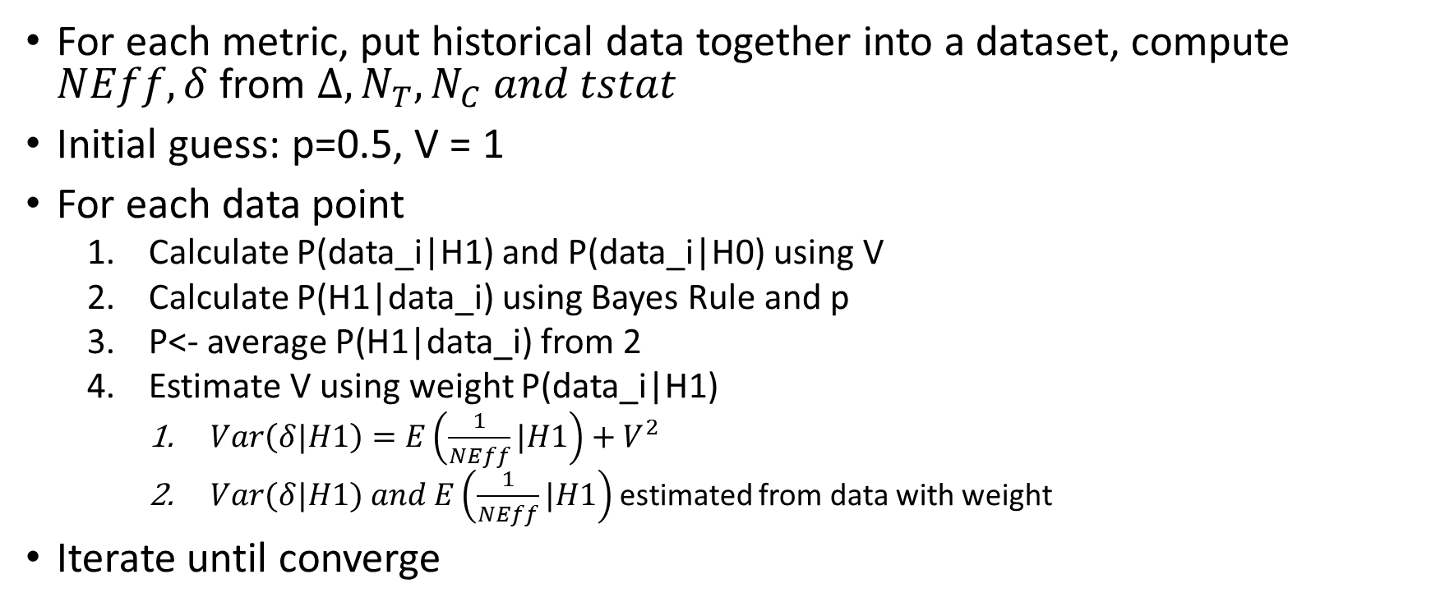
Learn p and V from historical data
For each metric, put historical data together into a dataset, compute $NEff, δ$ from $Δ, N_{T}, N_{C} and tstat$
Initial guess: p=0.5, V = 1
For each data point
Calculate P(data_i|H1) and P(data_i|H0) using V
Calculate P(H1|data_i) using Bayes Rule and p
P<- average P(H1|data_i) from 2
Estimate V using weight P(data_i|H1)
$Var\left(δ|H1\right)=E\left(\frac{1}{NEff}|H1\right)+V^{2}$
$Var(δ|H1) and E\left(\frac{1}{NEff}|H1\right)$ estimated from data with weight
Iterate until converge

Slide 26
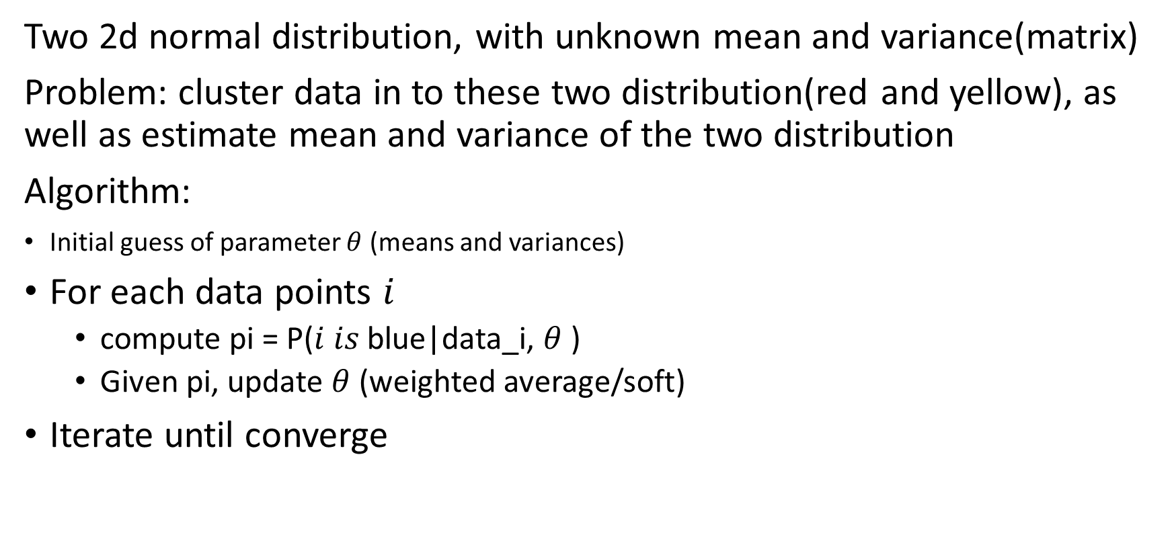
Soft k-means (via Expectation-Maximization)
Two 2d normal distribution, with unknown mean and variance(matrix)
Problem: cluster data in to these two distribution(red and yellow), as well as estimate mean and variance of the two distribution
Algorithm:
Initial guess of parameter $θ$ (means and variances)
For each data points $i$
compute pi = P($i is$blue|data_i, $θ$ )
Given pi, update $θ$ (weighted average/soft)
Iterate until converge

